Slide 1
Batch Normalization
Notes:
https://towardsdatascience.com/batch-norm-explained-visually-how-it-works-and-why-neural-networks-need-it-b18919692739

Slide 2
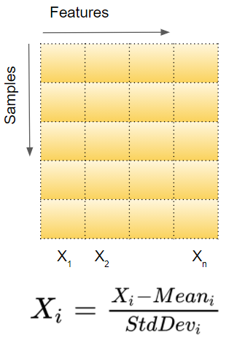
Normalizing Input Data

Slide 3
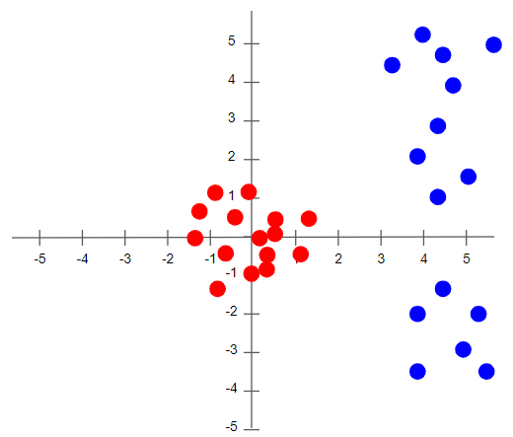
Normalizing Input Data

Slide 4
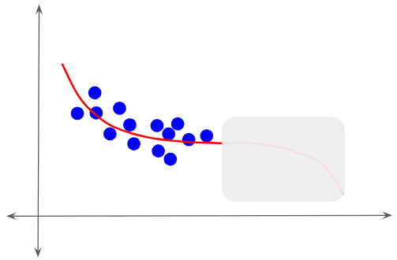
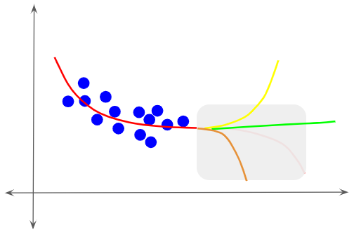
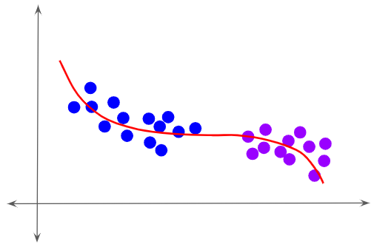
1. Covariate Shift

Slide 5
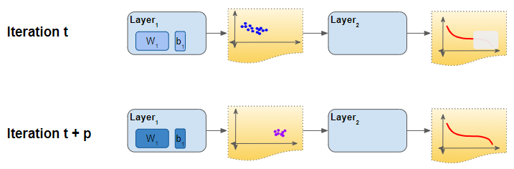
How Covariate Shift affects the training process
Normalize the activations from each previous layer then the gradient descent will converge better during training. This is what Batch Normalization does.

Slide 6
Batch Normalization
During training, each layer of the network learns an output function to fit its input.
However, in each iteration, the previous layer ‘k-1’ is also doing the same thing. It adjusts its output activations, effectively changing its distribution.
That is also the input for layer ‘k’. In other words, that layer receives input data that has a different distribution than before. It is now forced to learn to fit to this new input. As we can see, each layer ends up trying to learn from a constantly shifting input, thus taking longer to converge and slowing down the training.
Batch Norm helps to stabilize these shifting distributions from one iteration to the next, and thus speeds up training.

Slide 7
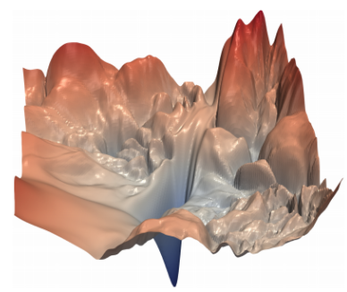
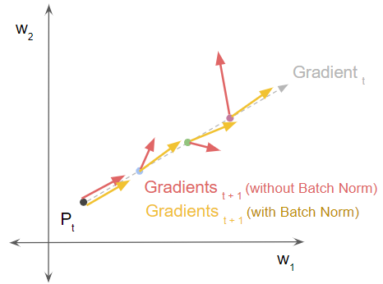
2. Loss and Gradient Smoothening

Slide 8
Batch Normalization
Batch Norm significantly smoothens the loss landscape.

Slide 9
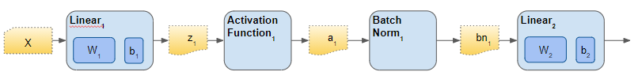
How Does Batch Norm work?

Slide 10
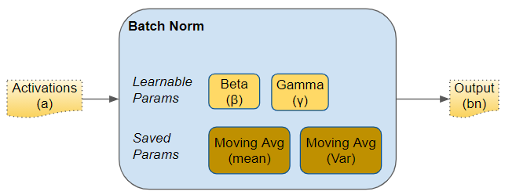
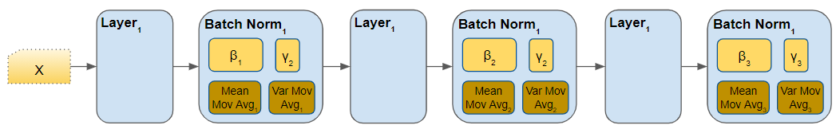
How Does Batch Norm work?

Slide 11
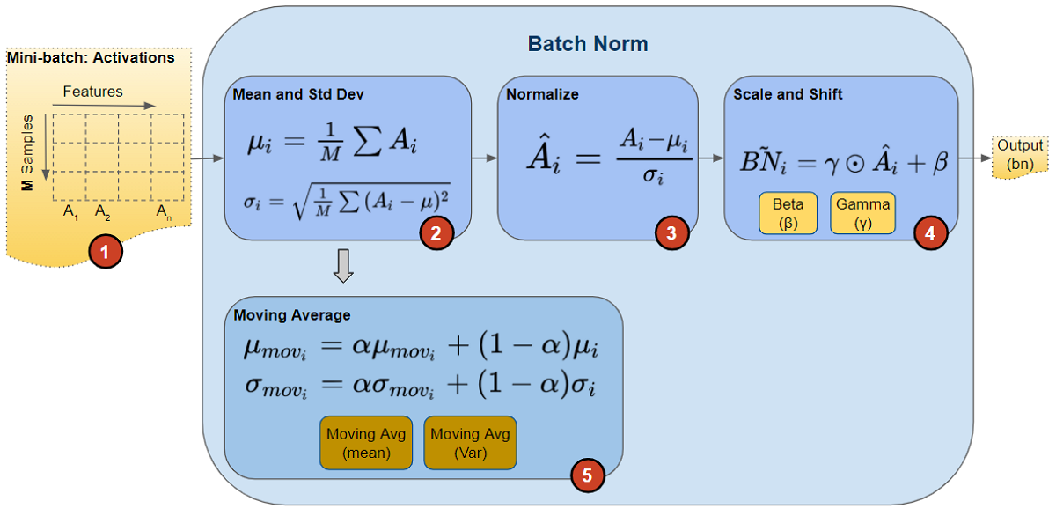
scalar ‘momentum’ denoted by alpha

